Slide 1



KONGU ENGINEERING COLLEGE
PERUNDURAI ERODE-638060
DEPARTMENT OF COMPUTER
APPLICATIONS
ISSUES IN TESTING OBJECT ORIENTED SOFTWARE
BY
M.HARIPRIYA
II-MCA-A

Slide 2
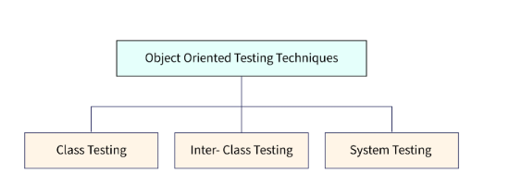
ISSUES IN TESTING OBJECT ORIENTED SOFTWARE
Different Levels of Object-Oriented Testing in Software Testing

Slide 3
Object Oriented testing can be performed at different levels to detect the issues.
At the algorithmic level, a single module of every class should be tested.
Every class gets tested as an individual entity at the class level.
Generally, programmers who are creating the classes are involved in testing.
Test cases for Object-Oriented Testing in Software Testing can be constructed based on the requirement specifications, programming language, and models.

Slide 4
Once class-level testing is done, Cluster level testing will be performed.
Cluster-level testing is the integration of individual classes.
The main purpose of doing integration testing is to verify the interconnection between classes and how well they perform interclass interactions.
Thus, Cluster level testing can be viewed as integration testing of classes.
Once Cluster level testing is performed, system-level testing begins.
At this level, integration between clusters can be taken care of. Also, at each level regression testing is a must after every new release.

Slide 5
Developing Test Cases in Object-oriented Testing
How to develop test cases in Object Oriented Testing in Software Testing?
Conventional methods can be used to design test cases in OO testing.
However, these test cases can be redeveloped with some special features so that they can use for object-oriented environments.

Slide 6
The following points should be considered while creating test cases for object-oriented environments.
Which class is going to be tested should be mentioned properly within the test cases.
What is the purpose of using particular test cases?
What external pre-condition needs to be conducted while performing the test case?
All the states should be specified for testing.

Slide 7
THANK YOU!

